Slide 1

Glenn Ross-Dolan
M.Sc. Bioinformatics and Computational Biology
F2F Meeting - 04-09-2024

Slide 2
Meeting Agenda
Discuss EEC subpopulations
Discuss Pdlim2
Discuss plan for the next 4 weeks

Slide 3
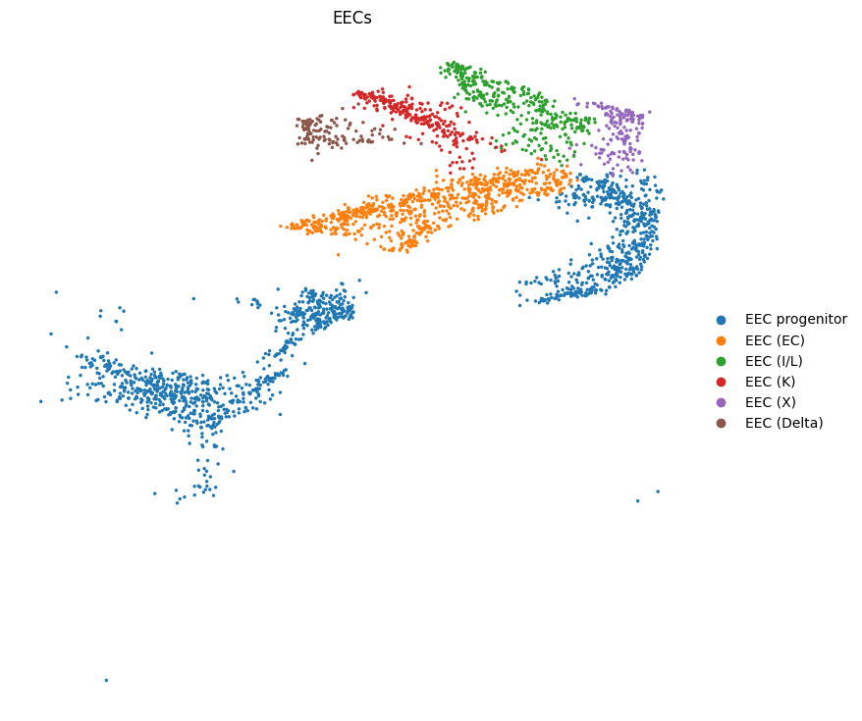
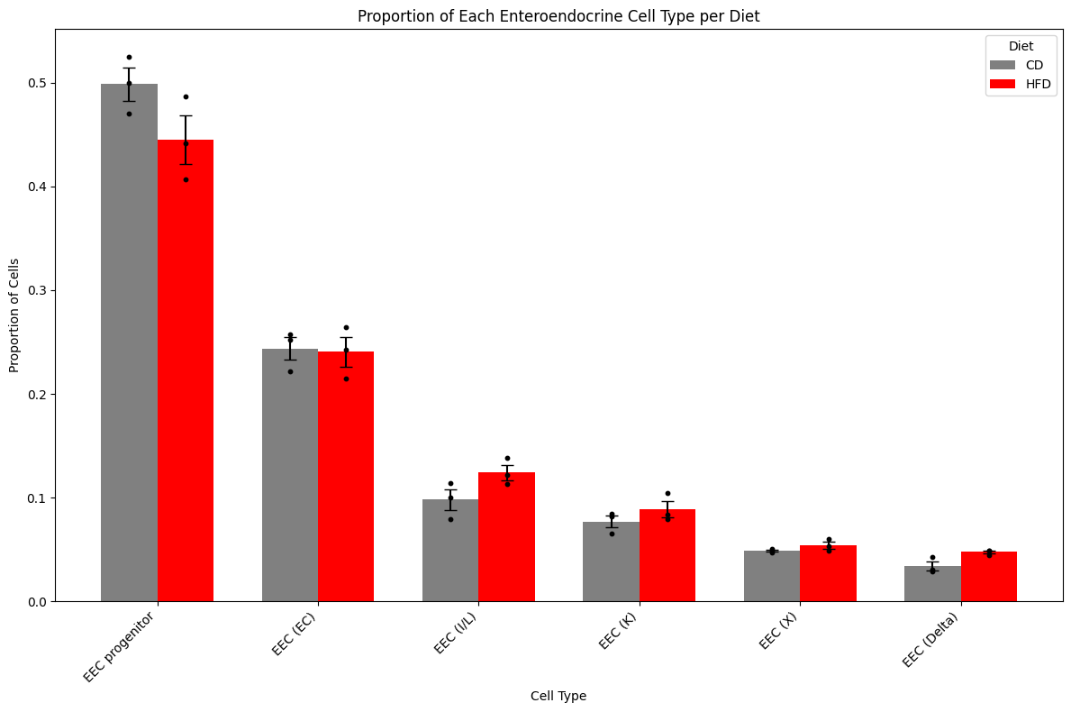
EEC subpopulations
No enriched pathways found in any EEC subcluster
Still to report volcano plot of differentially expressed genes

Slide 4
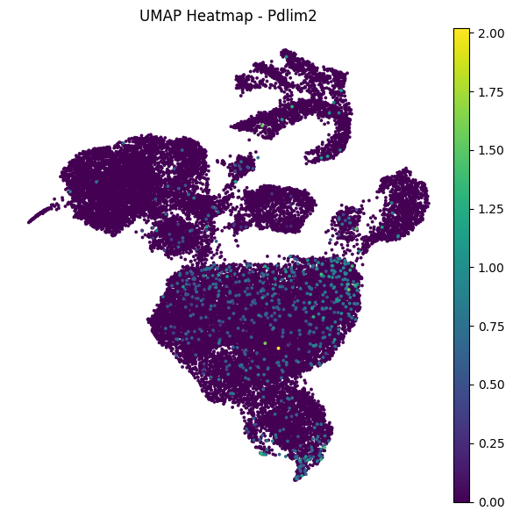
Feature plot of Pdlim2 Expression
Each dot represents a cell
Colour represents the normalised count of ‘Pdlim2’
It’s apparent that the expression of Pdlim2 is very low in this dataset, the max being 2 counts. This dataset is likely unsuitable for further analysis.
Deeper sequencing may capture more Pdlim2 fragments and thus more nuances of how Pdlim2 is affected by the HFHS diet.

Slide 5
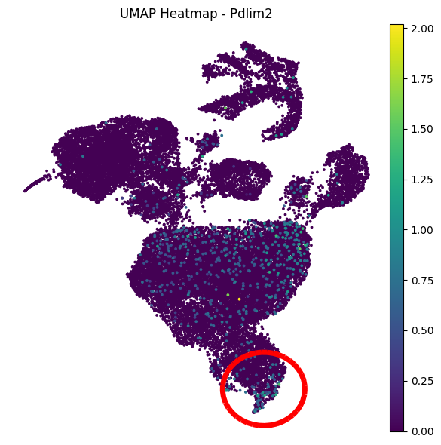
Let’s entertain the idea anyway …
It appears that there may be a subcluster of the enterocyte population where Pdlim2 expression is more frequently captured.
We can recluster the enterocytes to select for these cells and thus enrich for Pdlim2 expressers.
Reclustering is achieved with an unsupervised leiden clustering algorithm.

Slide 6
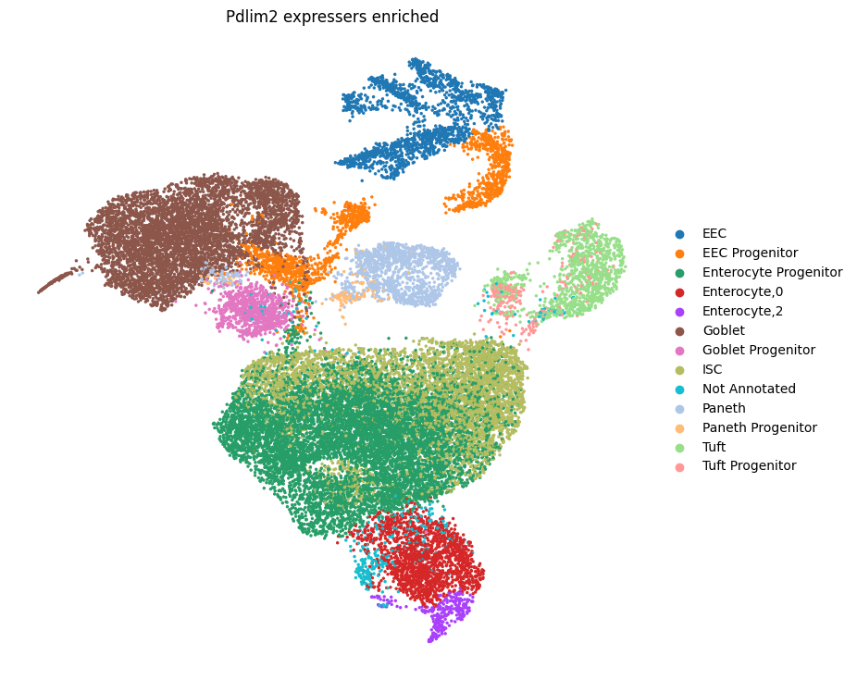
And voila
Ignore the colour changes of the clusters as they’re irrelevant.
Using these new annotations we can investigate potential differences of Pdlim2 expression between the diets in this new enterocyte subcluster.

Slide 7
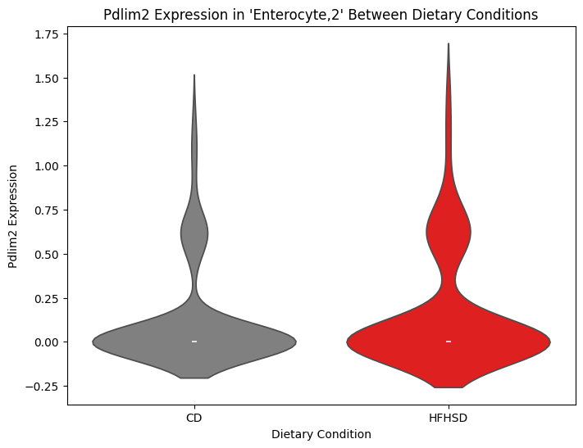
Violin plots of Pdlim2 Expression of the new cluster
There are no apparent changes in the expression of Pdlim2 between the two diets of this new cluster.

Slide 8
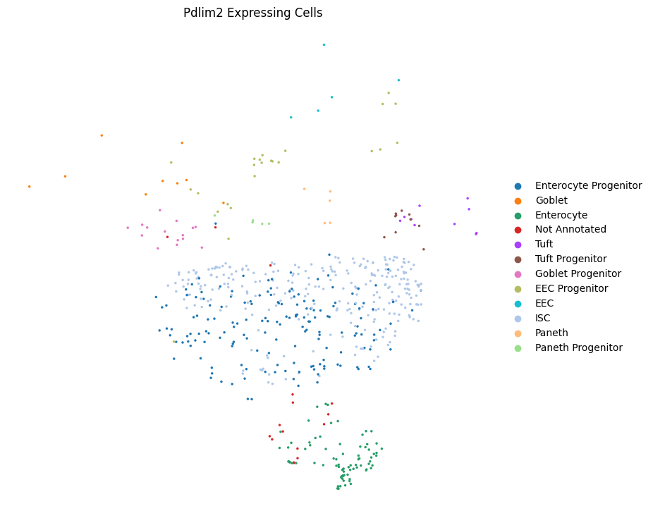
Let’s go even further
Let’s subset the data to only cells showing expression of Pdlim2
This is bad practice as technically even cells with a Pdlim2 count of zero are still expressing Pdlim2. It’s just the case that the sequencing depth was not deep enough to capture them …
Here you can see only cells which are shown to express Pdlim2

Slide 9
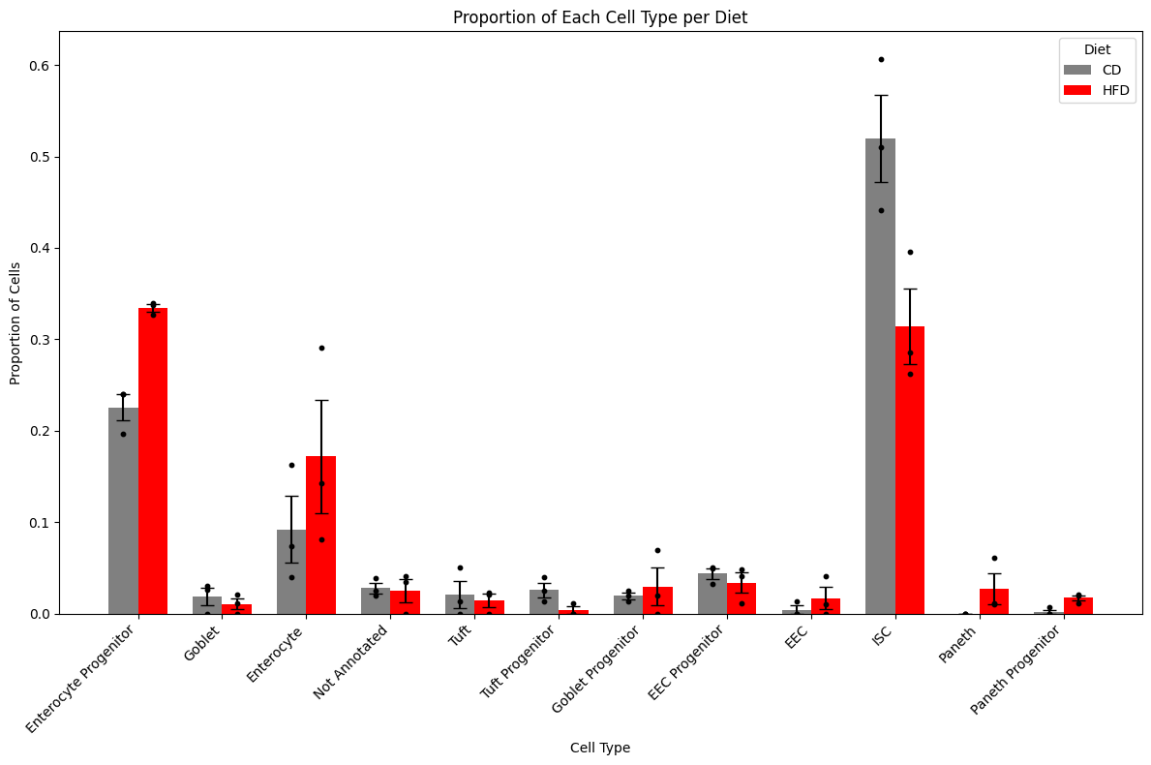
Barplot of proportions of cell types in Pdlim2 positive cells
Here we see very similar trends to the full dataset.
As before, CD ISCs are of greater proportions than HFHSD ISCs.
Similar results for enterocyte progenitors also.

Slide 10
4 week plan
Week 1 - Complete literature review
Week 2 - Complete Results/ Methods
Week 3 - Complete Discussion
Week 4 - Finalise the revisions of the draft
Other tasks:
Keep everyone updated via weekly emails
Report villus fraction results
If time permits, run bulk data through pipeline and use results to support current results/hypotheses

